Slide 1


TensorFlow @UST
Day 2: CNN
Sung Kim <hunkim+tfust@gmail.com>

Slide 2
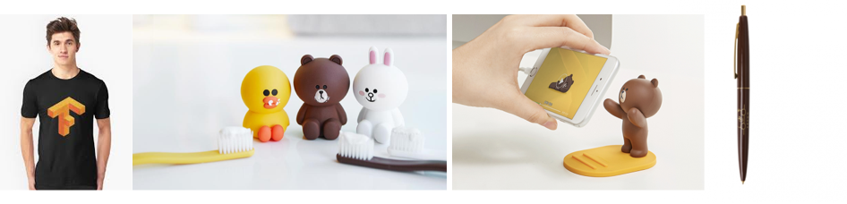


Gifts from Google and Line

Slide 3


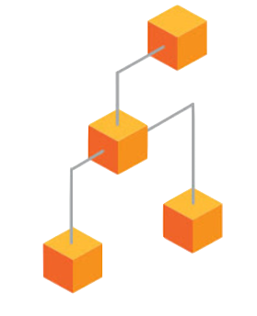



TensorFlow Mechanics
feed data and run graph (operation) sess.run (op, feed_dict={x: x_data})
Build graph using
TensorFlow operations
update variables
in the graph
(and return values)

Slide 4
Machine Learning Basics
Linear Regression
Logistic Regression (Binary classification)
Softmax Classification
Neural Networks

Slide 5
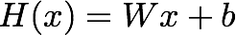
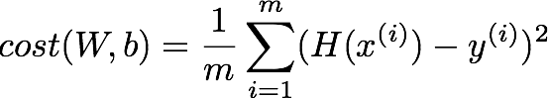
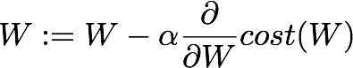
Linear Regression
W = tf.Variable(tf.random_normal([1]), name='weight')
b = tf.Variable(tf.random_normal([1]), name='bias')
# Our hypothesis XW+b
hypothesis = X * W + b
# cost/loss function
cost = tf.reduce_mean(tf.square(hypothesis - y_train))
GradientDescent
# Minimize
train = tf.train.GradientDescentOptimizer(learning_rate=0.01).minimize(cost)

Slide 6
Logistic Regression
Model? (Hypothesis?)
Cost?
GradientDescent
train = tf.train.GradientDescentOptimizer(learning_rate=0.01).minimize(cost)

Slide 7
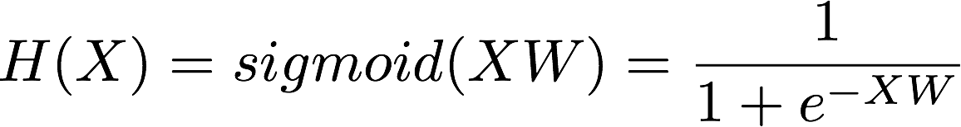
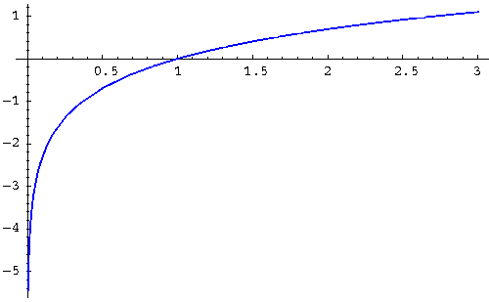
Logistic Regression
Model? (Hypothesis?)
hypothesis = tf.sigmoid(tf.matmul(X, W) + b)
Cost?
# cost/loss function
cost = -tf.reduce_mean(Y * tf.log(hypothesis) + (1 - Y) *
tf.log(1 - hypothesis))
GradientDescent
train = tf.train.GradientDescentOptimizer(learning_rate=0.01).minimize(cost)

Slide 8
Softmax Classifier
Model? (Hypothesis?)
logits = tf.matmul(X,W)+b
hypothesis = tf.nn.softmax(logits)
Cost?
# Cross entropy cost/loss
cost = tf.reduce_mean (-tf.reduce_sum(Y * tf.log(hypothesis), axis=1))
GradientDescent
train = tf.train.GradientDescentOptimizer(learning_rate=0.01).minimize(cost)

Slide 9
Softmax Classifier
Model? (Hypothesis?)
logits = tf.matmul(X,W)+b
hypothesis = tf.nn.softmax(logits)
Cost?
# Cross entropy cost/loss
cost = tf.reduce_mean (-tf.reduce_sum(Y * tf.log(hypothesis), axis=1))
cost = tf.reduce_mean(
tf.nn.softmax_cross_entropy_with_logits(logits=logits, labels=Y))
GradientDescent
train = tf.train.GradientDescentOptimizer(learning_rate=0.01).minimize(cost)

Slide 10
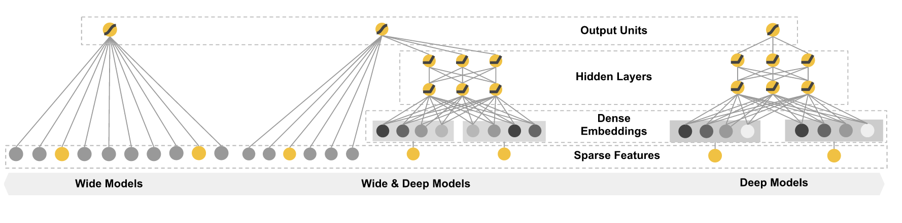
(Deep) Neural Nets
NN for MNIST
# input placeholders
X = tf.placeholder(tf.float32, [None, 784])
Y = tf.placeholder(tf.float32, [None, 10])
# weights & bias for nn layers
W1 = tf.Variable(tf.random_normal([784, 256]))
b1 = tf.Variable(tf.random_normal([256]))
L1 = tf.nn.relu(tf.matmul(X, W1) + b1)
W2 = tf.Variable(tf.random_normal([256, 256]))
b2 = tf.Variable(tf.random_normal([256]))
L2 = tf.nn.relu(tf.matmul(L1, W2) + b2)
W3 = tf.Variable(tf.random_normal([256, 10]))
b3 = tf.Variable(tf.random_normal([10]))
hypothesis = tf.matmul(L2, W3) + b3
# define cost/loss & optimizer
cost = tf.reduce_mean(tf.nn.softmax_cross_entropy_with_logits(
logits=hypothesis, labels=Y))
optimizer = tf.train.AdamOptimizer(learning_rate=learning_rate).minimize(cost)

Slide 11
NN tips
Initilizing weights
Activation functions
Regularization
Optimizers

Slide 12
Random?
W = tf.Variable(tf.random_normal([1]), name='weight')

Slide 13
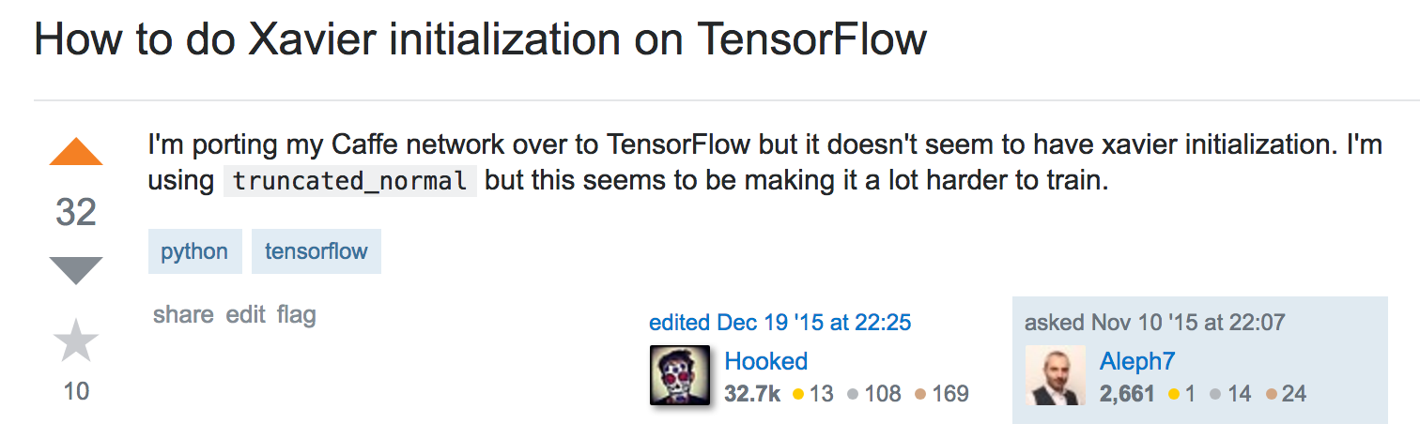
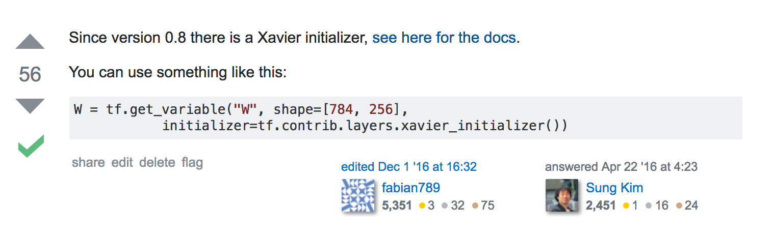
http://stackoverflow.com/questions/33640581/

Slide 14
NN tips
Initilizing weights
Activation functions
Regularization
Optimizers

Slide 15
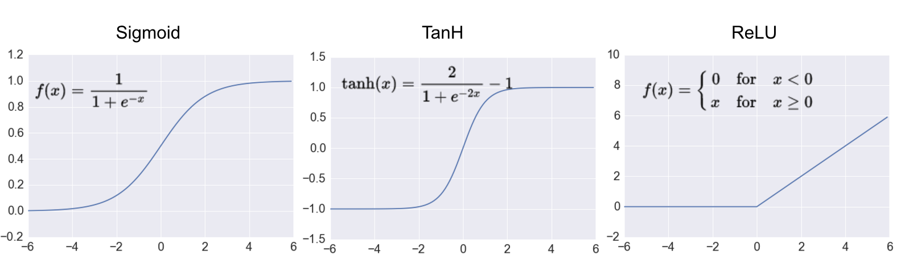
Activation functions
tf.tanh
tf.nn.relu
http://adilmoujahid.com/posts/2016/06/introduction-deep-learning-python-caffe/

Slide 16
Activation functions
tf.sigmoid
tf.tanh
tf.nn.relu
http://adilmoujahid.com/posts/2016/06/introduction-deep-learning-python-caffe/

Slide 17
NN tips
Initilizing weights
Activation functions
Regularization
Optimizers

Slide 18
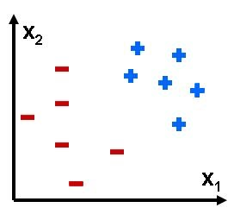

Overfitting

Slide 19
Am I overfitting?
Very high accuracy on the training dataset (eg: 0.99)
Poor accuracy on the test data set (0.85)

Slide 20
Solutions for overfitting
More training data!
Reduce the number of features
Regularization

Slide 21
Regularization
Let’s not have too big numbers in the weight

Slide 22
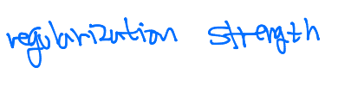
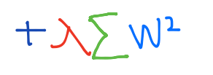
Regularization
Let’s not have too big numbers in the weight
cost

Slide 23
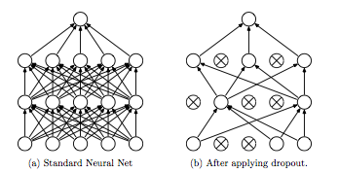
Dropout: A Simple Way to Prevent Neural Networks
from Overfitting [Srivastava et al. 2014]

Slide 24
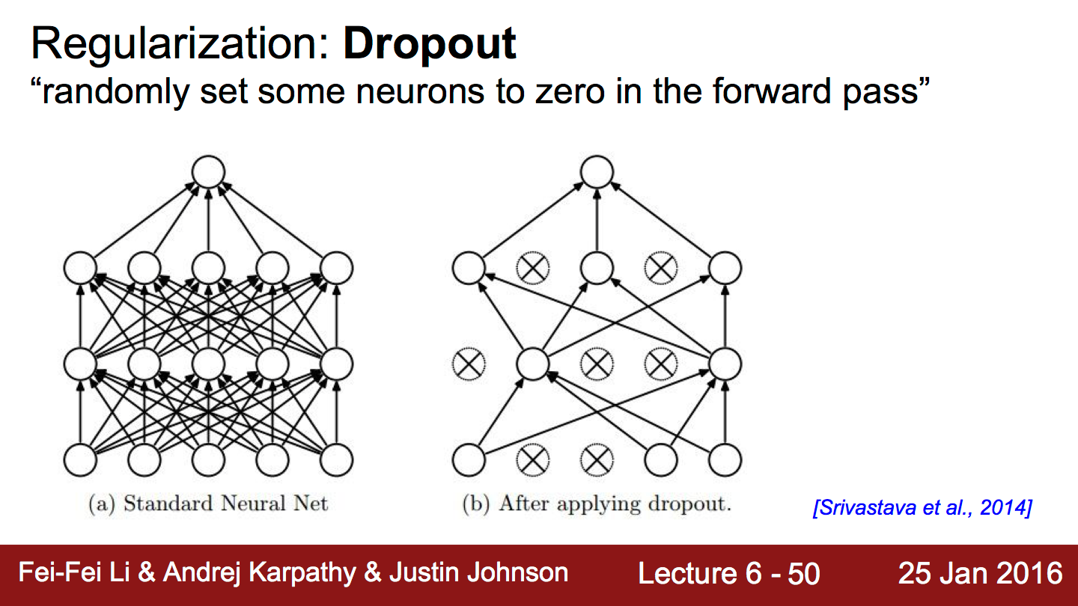
Notes:
how? randomly, 50, 60%?

Slide 25
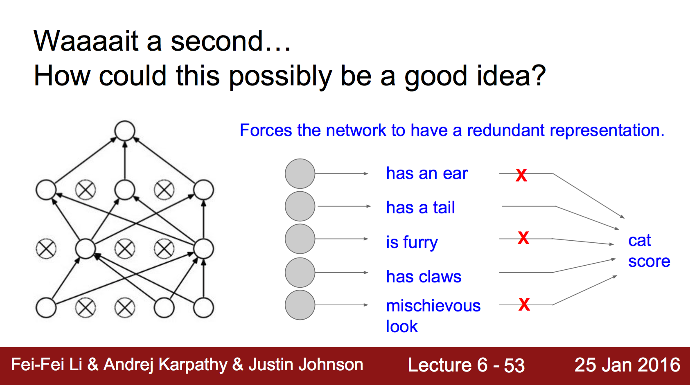

Slide 26
TensorFlow implementation
keep_prob = tf.placeholder("float")
L1 = …
L1_d = tf.nn.dropout(L1, keep_prob=keep_prob)
TRAIN:
sess.run(optimizer, feed_dict={X: batch_xs, Y: batch_ys, keep_prob: 0.7})
EVALUATION:
print "Accuracy:", accuracy.eval({X: mnist.test.images, Y: mnist.test.labels, keep_prob: 1})

Slide 27
# dropout (keep_prob) rate 0.7 on training, but should be 1 for testing
keep_prob = tf.placeholder(tf.float32)
W1 = tf.get_variable("W1", shape=[784, 512])
b1 = tf.Variable(tf.random_normal([512]))
L1 = tf.nn.relu(tf.matmul(X, W1) + b1)
L1 = tf.nn.dropout(L1, keep_prob=keep_prob)
W2 = tf.get_variable("W2", shape=[512, 512])
b2 = tf.Variable(tf.random_normal([512]))
L2 = tf.nn.relu(tf.matmul(L1, W2) + b2)
L2 = tf.nn.dropout(L2, keep_prob=keep_prob)
…
# train my model
for epoch in range(training_epochs):
...
for i in range(total_batch):
batch_xs, batch_ys = mnist.train.next_batch(batch_size)
feed_dict = {X: batch_xs, Y: batch_ys, keep_prob: 0.7}
c, _ = sess.run([cost, optimizer], feed_dict=feed_dict)
avg_cost += c / total_batch
# Test model and check accuracy
correct_prediction = tf.equal(tf.argmax(hypothesis, 1), tf.argmax(Y, 1))
accuracy = tf.reduce_mean(tf.cast(correct_prediction, tf.float32))
print('Accuracy:', sess.run(accuracy, feed_dict={
X: mnist.test.images, Y: mnist.test.labels, keep_prob: 1}))
Dropout for MNIST
https://github.com/hunkim/DeepLearningZeroToAll/blob/master/lab-10-5-mnist_nn_dropout.py

Slide 28
NN tips
Initilizing weights
Activation functions
Regularization
Optimizers

Slide 29
Optimizers
train = tf.train.GradientDescentOptimizer(learning_rate=0.1).minimize(cost)
https://www.tensorflow.org/api_guides/python/train

Slide 30
Optimizers
train = tf.train.GradientDescentOptimizer(learning_rate=0.1).minimize(cost)
tf.train.AdadeltaOptimizer
tf.train.AdagradOptimizer
tf.train.AdagradDAOptimizer
tf.train.MomentumOptimizer
tf.train.AdamOptimizer
tf.train.FtrlOptimizer
tf.train.ProximalGradientDescentOptimizer
tf.train.ProximalAdagradOptimizer
tf.train.RMSPropOptimizer
https://www.tensorflow.org/api_guides/python/train

Slide 31
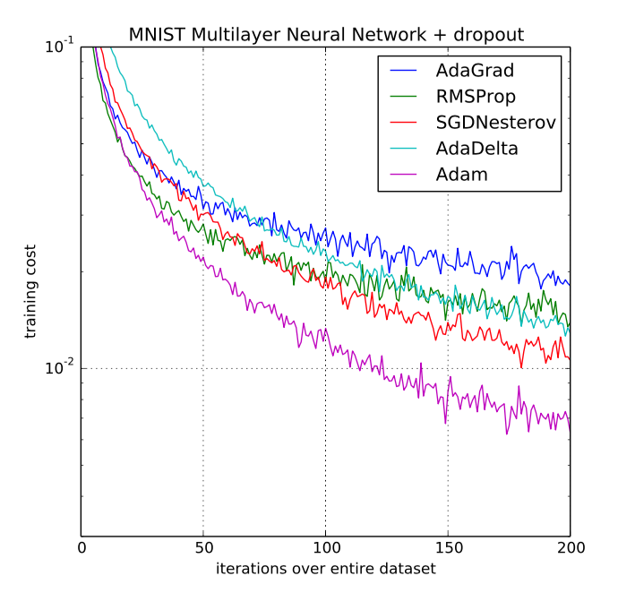
ADAM: a method for stochastic optimization
[Kingma et al. 2015]

Slide 32
Use Adam Optimizer
# define cost/loss & optimizer
cost = tf.reduce_mean(tf.nn.softmax_cross_entropy_with_logits(
logits=hypothesis, labels=Y))
optimizer = tf.train.AdamOptimizer(learning_rate=learning_rate).minimize(cost)

Slide 33
TensorFlow @UST
Day 2: CNN
Sung Kim <hunkim+tfust@gmail.com>

Slide 34
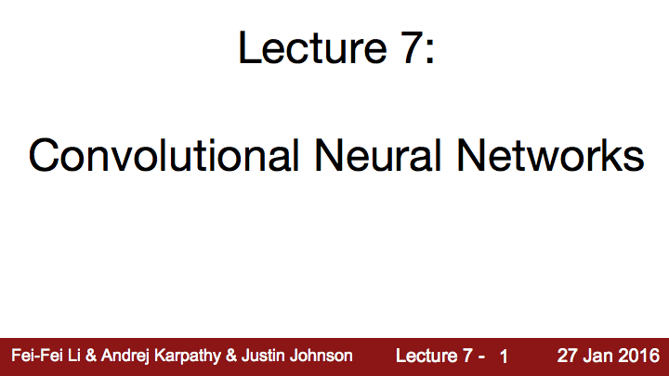
http://cs231n.stanford.edu/

Slide 35
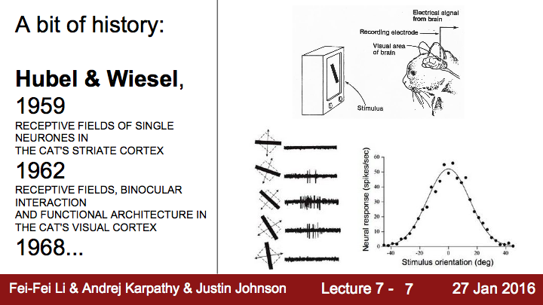

Slide 36
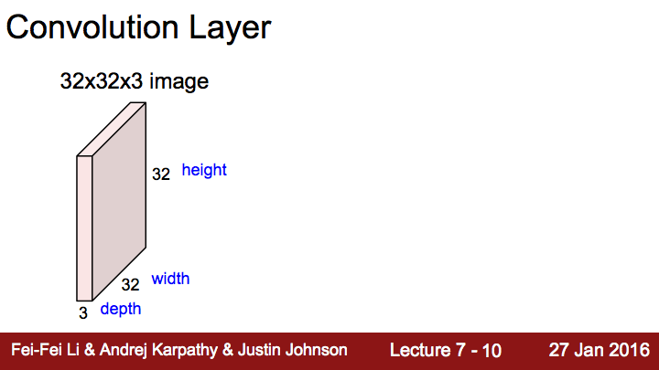

Slide 37
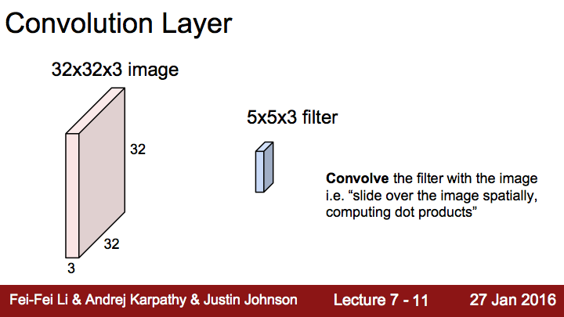

Slide 38
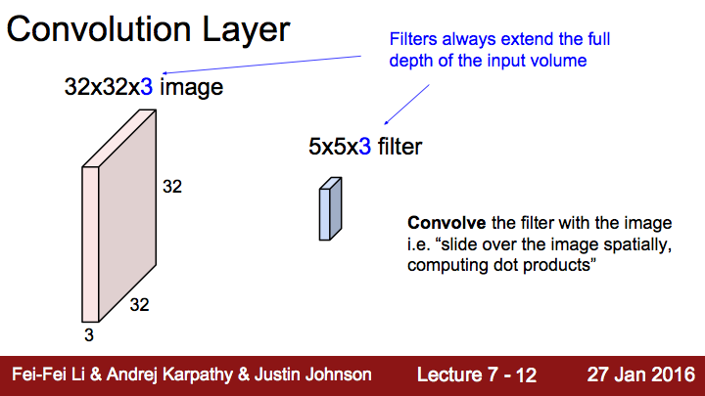

Slide 39
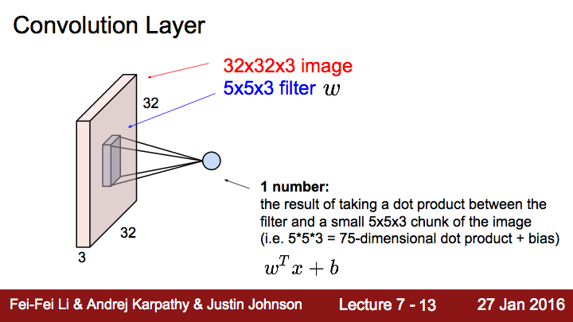

Slide 40
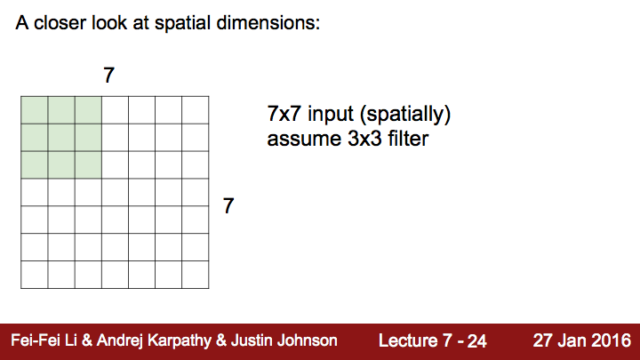

Slide 41
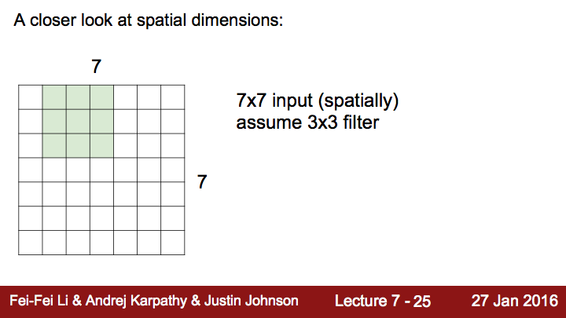

Slide 42
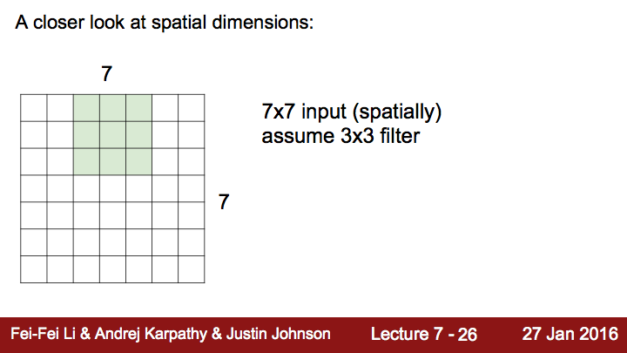

Slide 43
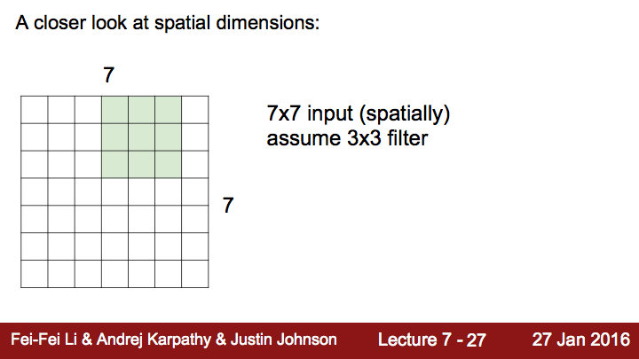

Slide 44
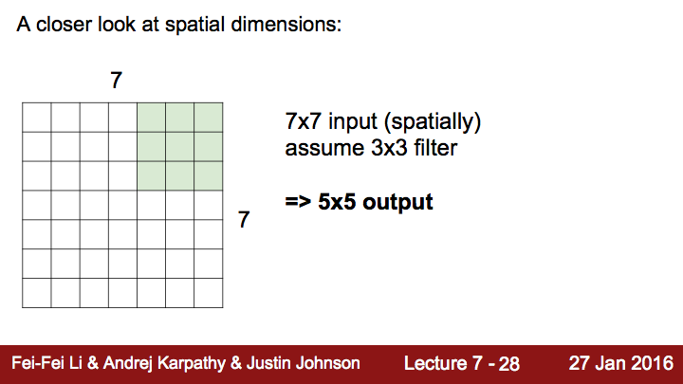

Slide 45
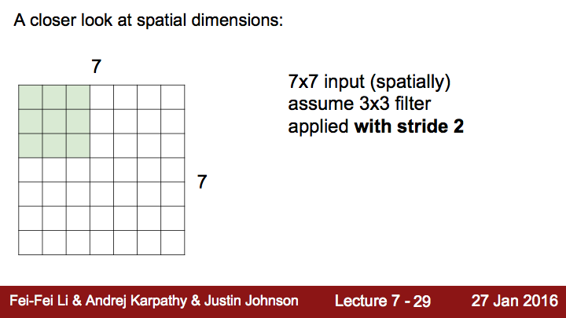

Slide 46
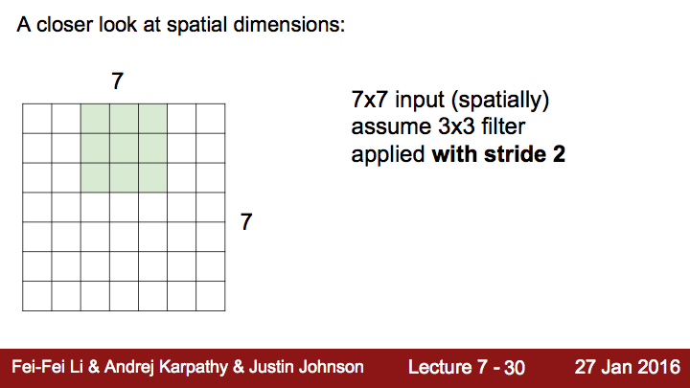

Slide 47
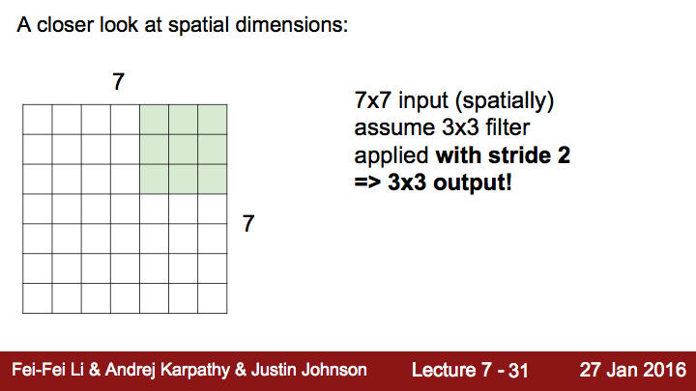

Slide 48
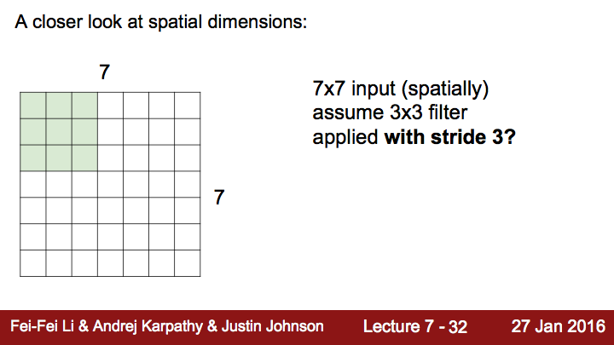

Slide 49
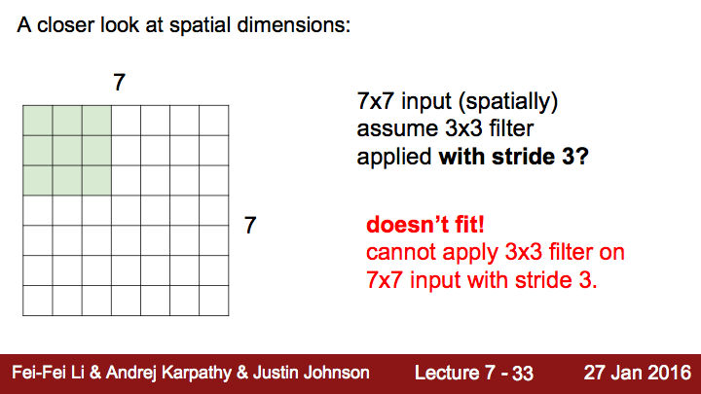

Slide 50
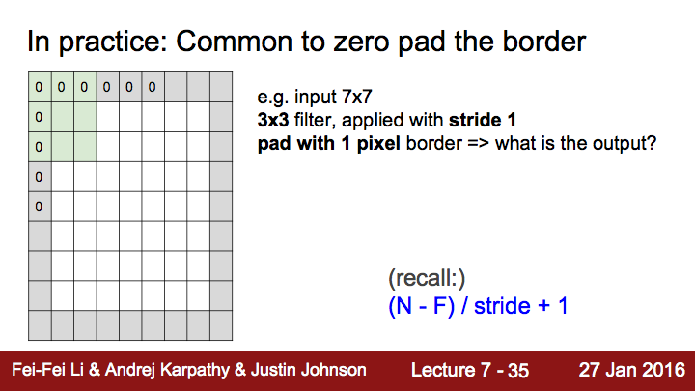

Slide 51
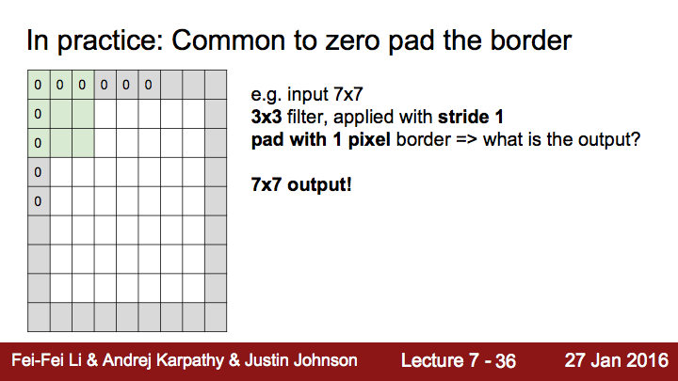

Slide 52
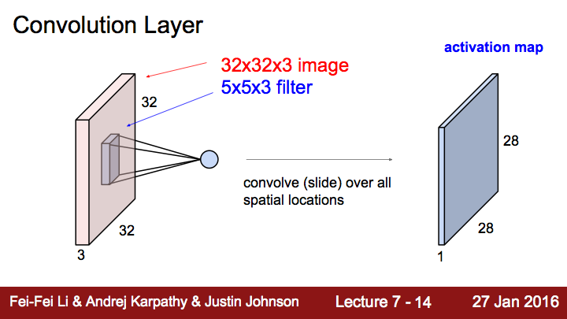

Slide 53
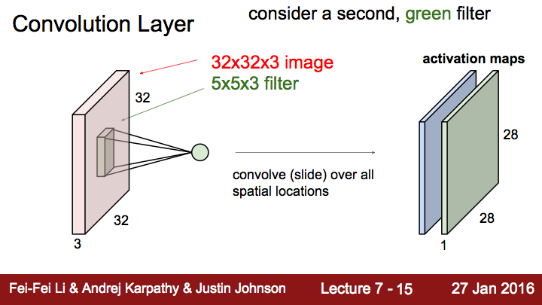

Slide 54
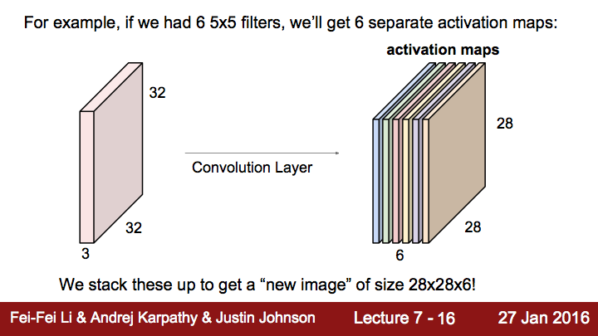

Slide 55
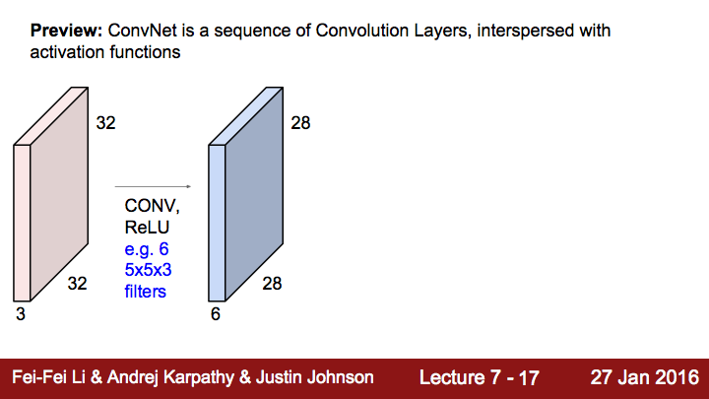

Slide 56
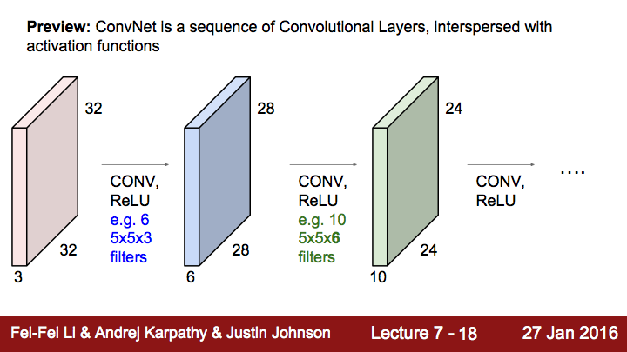

Slide 57
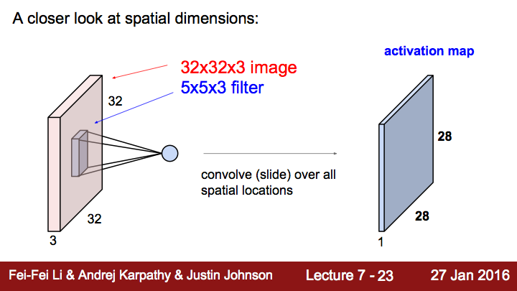

Slide 58
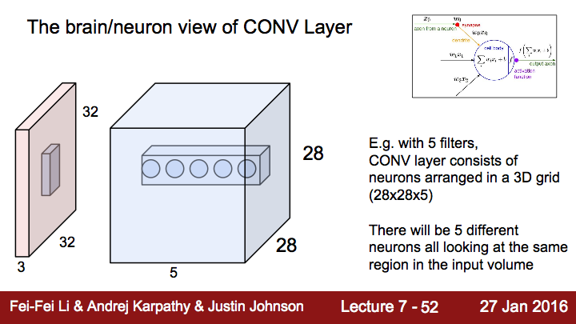

Slide 59
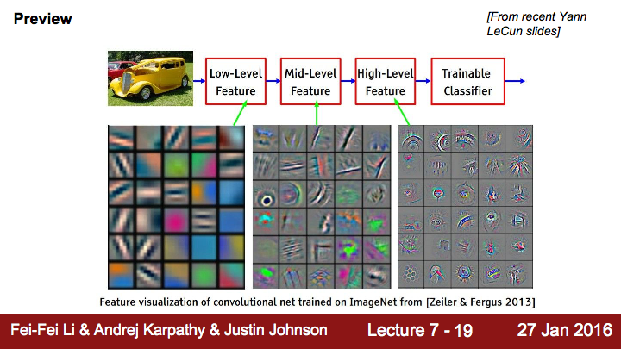

Slide 60
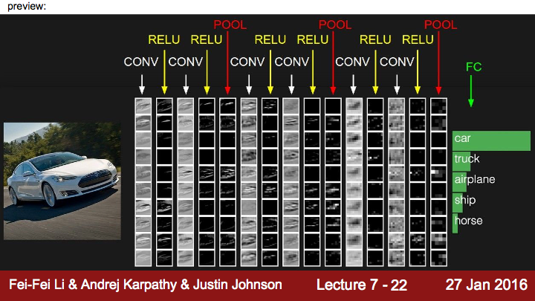

Slide 61
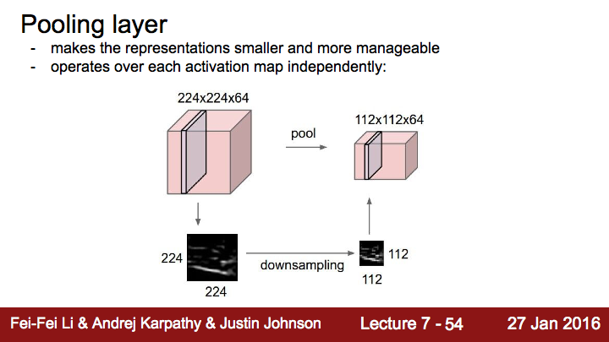

Slide 62
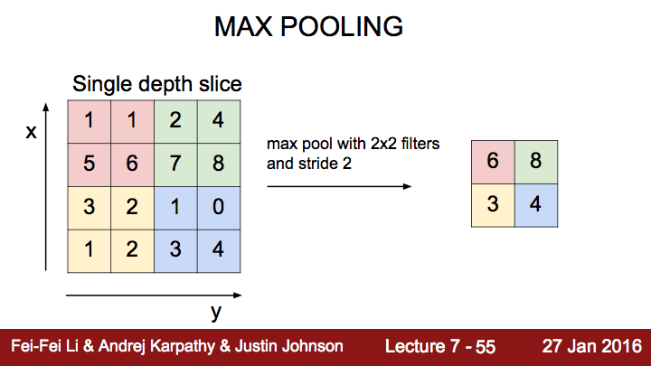

Slide 63
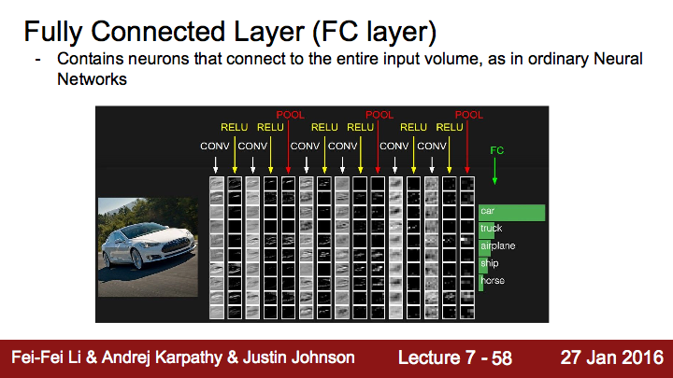

Slide 64
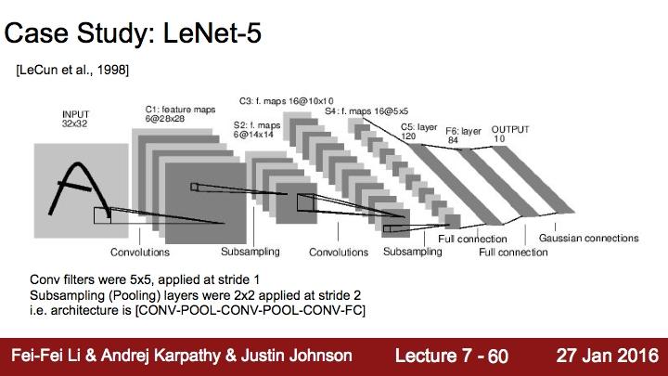

Slide 65
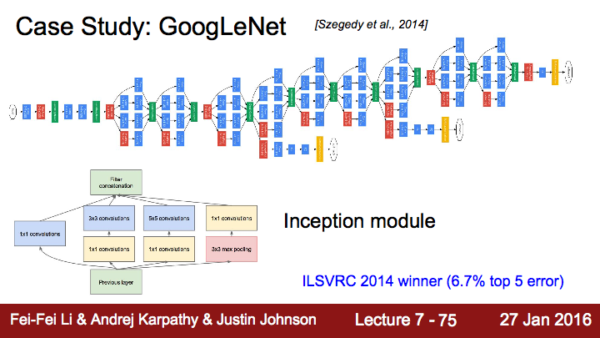

Slide 66

Convolutional Neural Networks for Sentence Classification [Yoon Kim, 2014]

Slide 67

CNN Basics
With TF 1.0!
Sung Kim <hunkim+ml@gmail.com>
Code: https://github.com/hunkim/DeepLearningZeroToAll/

Slide 68
CNN
http://parse.ele.tue.nl/cluster/2/CNNArchitecture.jpg

Slide 69

CNN for CT images
Asan Medical Center & Microsoft Medical Bigdata Contest Winner by GeunYoung Lee and Alex Kim
https://www.slideshare.net/GYLee3/ss-72966495

Slide 70



Convolution layer and max pooling

Slide 71



Simple convolution layer
Stride: 1x1
3x3x1
2x2x1 filter

Slide 72

Toy image

Slide 73


Simple convolution layer
Image: 1,3,3,1 image, Filter: 2,2,1,1, Stride: 1x1, Padding: VALID
3
2
1
6
1
5
1
4
1
9
8
1
7
[[[[1.]],[[1.]]],
[[[1.]],[[1.]]]]
shape=(2,2,1,1)

Slide 74

Image: 1,3,3,1 image, Filter: 2,2,1,1, Stride: 1x1, Padding: VALID
3
2
1
6
1
5
1
4
1
9
8
1
7

Slide 75
Simple convolution layer
Image: 1,3,3,1 image, Filter: 2,2,1,1, Stride: 1x1, Padding: SAME
0
3
2
1
0
6
1
5
1
3
4
0
1
9
8
0
1
7
0
3
0
0

Slide 76

Image: 1,3,3,1 image, Filter: 2,2,1,1, Stride: 1x1, Padding: SAME
0
3
2
1
0
6
1
5
1
4
0
1
9
8
0
1
7
0
0
0

Slide 77


Slide 78



Max Pooling
https://github.com/hunkim/DeepLearningZeroToAll/blob/master/lab-11-0-cnn_basics.ipynb

Slide 79

MNIST image loading
https://github.com/hunkim/DeepLearningZeroToAll/blob/master/lab-11-0-cnn_basics.ipynb

Slide 80

MNIST Convolution layer
https://github.com/hunkim/DeepLearningZeroToAll/blob/master/lab-11-0-cnn_basics.ipynb

Slide 81

MNIST Max pooling
https://github.com/hunkim/DeepLearningZeroToAll/blob/master/lab-11-0-cnn_basics.ipynb

Slide 82
CNN MNIST 99%
With TF 1.0!
Sung Kim <hunkim+ml@gmail.com>
Code: https://github.com/hunkim/DeepLearningZeroToAll/

Slide 83
CNN
http://parse.ele.tue.nl/cluster/2/CNNArchitecture.jpg

Slide 84

Simple CNN

Slide 85

Conv layer 1
# input placeholders
X = tf.placeholder(tf.float32, [None, 784])
X_img = tf.reshape(X, [-1, 28, 28, 1]) # img 28x28x1 (black/white)
Y = tf.placeholder(tf.float32, [None, 10])
# L1 ImgIn shape=(?, 28, 28, 1)
W1 = tf.Variable(tf.random_normal([3, 3, 1, 32], stddev=0.01))
# Conv -> (?, 28, 28, 32)
# Pool -> (?, 14, 14, 32)
L1 = tf.nn.conv2d(X_img, W1, strides=[1, 1, 1, 1], padding='SAME')
L1 = tf.nn.relu(L1)
L1 = tf.nn.max_pool(L1, ksize=[1, 2, 2, 1],
strides=[1, 2, 2, 1], padding='SAME')
'''
Tensor("Conv2D:0", shape=(?, 28, 28, 32), dtype=float32)
Tensor("Relu:0", shape=(?, 28, 28, 32), dtype=float32)
Tensor("MaxPool:0", shape=(?, 14, 14, 32), dtype=float32)
'''
https://github.com/hunkim/DeepLearningZeroToAll/blob/master/lab-11-1-mnist_cnn.py

Slide 86
Conv layer 2
'''
Tensor("Conv2D:0", shape=(?, 28, 28, 32), dtype=float32)
Tensor("Relu:0", shape=(?, 28, 28, 32), dtype=float32)
Tensor("MaxPool:0", shape=(?, 14, 14, 32), dtype=float32)
'''
# L2 ImgIn shape=(?, 14, 14, 32)
W2 = tf.Variable(tf.random_normal([3, 3, 32, 64], stddev=0.01))
# Conv ->(?, 14, 14, 64)
# Pool ->(?, 7, 7, 64)
L2 = tf.nn.conv2d(L1, W2, strides=[1, 1, 1, 1], padding='SAME')
L2 = tf.nn.relu(L2)
L2 = tf.nn.max_pool(L2, ksize=[1, 2, 2, 1], strides=[1, 2, 2, 1], padding='SAME')
L2 = tf.reshape(L2, [-1, 7 * 7 * 64])
'''
Tensor("Conv2D_1:0", shape=(?, 14, 14, 64), dtype=float32)
Tensor("Relu_1:0", shape=(?, 14, 14, 64), dtype=float32)
Tensor("MaxPool_1:0", shape=(?, 7, 7, 64), dtype=float32)
Tensor("Reshape_1:0", shape=(?, 3136), dtype=float32)
https://github.com/hunkim/DeepLearningZeroToAll/blob/master/lab-11-1-mnist_cnn.py

Slide 87
Fully Connected (FC, Dense) layer
'''
Tensor("Conv2D_1:0", shape=(?, 14, 14, 64), dtype=float32)
Tensor("Relu_1:0", shape=(?, 14, 14, 64), dtype=float32)
Tensor("MaxPool_1:0", shape=(?, 7, 7, 64), dtype=float32)
Tensor("Reshape_1:0", shape=(?, 3136), dtype=float32)
'''
L2 = tf.reshape(L2, [-1, 7 * 7 * 64])
# Final FC 7x7x64 inputs -> 10 outputs
W3 = tf.get_variable("W3", shape=[7 * 7 * 64, 10], initializer=tf.contrib.layers.xavier_initializer())
b = tf.Variable(tf.random_normal([10]))
hypothesis = tf.matmul(L2, W3) + b
# define cost/loss & optimizer
cost = tf.reduce_mean(tf.nn.softmax_cross_entropy_with_logits(logits=hypothesis, labels=Y))
optimizer = tf.train.AdamOptimizer(learning_rate=learning_rate).minimize(cost)
https://github.com/hunkim/DeepLearningZeroToAll/blob/master/lab-11-1-mnist_cnn.py

Slide 88
Training and Evaluation
# initialize
sess = tf.Session()
sess.run(tf.global_variables_initializer())
# train my model
print('Learning stared. It takes sometime.')
for epoch in range(training_epochs):
avg_cost = 0
total_batch = int(mnist.train.num_examples / batch_size)
for i in range(total_batch):
batch_xs, batch_ys = mnist.train.next_batch(batch_size)
feed_dict = {X: batch_xs, Y: batch_ys}
c, _, = sess.run([cost, optimizer], feed_dict=feed_dict)
avg_cost += c / total_batch
print('Epoch:', '%04d' % (epoch + 1), 'cost =', '{:.9f}'.format(avg_cost))
print('Learning Finished!')
# Test model and check accuracy
correct_prediction = tf.equal(tf.argmax(hypothesis, 1), tf.argmax(Y, 1))
accuracy = tf.reduce_mean(tf.cast(correct_prediction, tf.float32))
print('Accuracy:', sess.run(accuracy, feed_dict={X: mnist.test.images, Y: mnist.test.labels}))
https://github.com/hunkim/DeepLearningZeroToAll/blob/master/lab-11-1-mnist_cnn.py

Slide 89
Training and Evaluation
# initialize
sess = tf.Session()
sess.run(tf.global_variables_initializer())
# train my model
print('Learning stared. It takes sometime.')
for epoch in range(training_epochs):
avg_cost = 0
total_batch = int(mnist.train.num_examples / batch_size)
for i in range(total_batch):
batch_xs, batch_ys = mnist.train.next_batch(batch_size)
feed_dict = {X: batch_xs, Y: batch_ys}
c, _, = sess.run([cost, optimizer], feed_dict=feed_dict)
avg_cost += c / total_batch
print('Epoch:', '%04d' % (epoch + 1), 'cost =', '{:.9f}'.format(avg_cost))
print('Learning Finished!')
# Test model and check accuracy
correct_prediction = tf.equal(tf.argmax(hypothesis, 1), tf.argmax(Y, 1))
accuracy = tf.reduce_mean(tf.cast(correct_prediction, tf.float32))
print('Accuracy:', sess.run(accuracy, feed_dict={X: mnist.test.images, Y: mnist.test.labels}))
Epoch: 0001 cost = 0.340291267
Epoch: 0002 cost = 0.090731326
Epoch: 0003 cost = 0.064477619
Epoch: 0004 cost = 0.050683064
...
Epoch: 0011 cost = 0.017758641
Epoch: 0012 cost = 0.014156652
Epoch: 0013 cost = 0.012397016
Epoch: 0014 cost = 0.010693789
Epoch: 0015 cost = 0.009469977
Learning Finished!
Accuracy: 0.9885
https://github.com/hunkim/DeepLearningZeroToAll/blob/master/lab-11-1-mnist_cnn.py

Slide 90

Deep CNN
Image credit: http://personal.ie.cuhk.edu.hk/~ccloy/project_target_code/index.html

Slide 91
Deep CNN
# L3 ImgIn shape=(?, 7, 7, 64)
W3 = tf.Variable(tf.random_normal([3, 3, 64, 128], stddev=0.01))
# Conv ->(?, 7, 7, 128)
# Pool ->(?, 4, 4, 128)
# Reshape ->(?, 4 * 4 * 128) # Flatten them for FC
L3 = tf.nn.conv2d(L2, W3, strides=[1, 1, 1, 1], padding='SAME')
L3 = tf.nn.relu(L3)
L3 = tf.nn.max_pool(L3, ksize=[1, 2, 2, 1], strides=[1, 2, 2, 1], padding='SAME')
L3 = tf.nn.dropout(L3, keep_prob=keep_prob)
L3 = tf.reshape(L3, [-1, 128 * 4 * 4])
'''Tensor("Conv2D_2:0", shape=(?, 7, 7, 128), dtype=float32)
Tensor("Relu_2:0", shape=(?, 7, 7, 128), dtype=float32)
Tensor("MaxPool_2:0", shape=(?, 4, 4, 128), dtype=float32)
Tensor("dropout_2/mul:0", shape=(?, 4, 4, 128), dtype=float32)
Tensor("Reshape_1:0", shape=(?, 2048), dtype=float32)'''
# L4 FC 4x4x128 inputs -> 625 outputs
W4 = tf.get_variable("W4", shape=[128 * 4 * 4, 625], initializer=tf.contrib.layers.xavier_initializer())
b4 = tf.Variable(tf.random_normal([625]))
L4 = tf.nn.relu(tf.matmul(L3, W4) + b4)
L4 = tf.nn.dropout(L4, keep_prob=keep_prob)
'''Tensor("Relu_3:0", shape=(?, 625), dtype=float32)
Tensor("dropout_3/mul:0", shape=(?, 625), dtype=float32)'''
# L5 Final FC 625 inputs -> 10 outputs
W5 = tf.get_variable("W5", shape=[625, 10], initializer=tf.contrib.layers.xavier_initializer())
b5 = tf.Variable(tf.random_normal([10]))
hypothesis = tf.matmul(L4, W5) + b5
'''Tensor("add_1:0", shape=(?, 10), dtype=float32)'''
# L1 ImgIn shape=(?, 28, 28, 1)
W1 = tf.Variable(tf.random_normal([3, 3, 1, 32], stddev=0.01))
# Conv -> (?, 28, 28, 32)
# Pool -> (?, 14, 14, 32)
L1 = tf.nn.conv2d(X_img, W1, strides=[1, 1, 1, 1], padding='SAME')
L1 = tf.nn.relu(L1)
L1 = tf.nn.max_pool(L1, ksize=[1, 2, 2, 1],
strides=[1, 2, 2, 1], padding='SAME')
L1 = tf.nn.dropout(L1, keep_prob=keep_prob)
'''Tensor("Conv2D:0", shape=(?, 28, 28, 32), dtype=float32)
Tensor("Relu:0", shape=(?, 28, 28, 32), dtype=float32)
Tensor("MaxPool:0", shape=(?, 14, 14, 32), dtype=float32)
Tensor("dropout/mul:0", shape=(?, 14, 14, 32), dtype=float32)'''
# L2 ImgIn shape=(?, 14, 14, 32)
W2 = tf.Variable(tf.random_normal([3, 3, 32, 64], stddev=0.01))
# Conv ->(?, 14, 14, 64)
# Pool ->(?, 7, 7, 64)
L2 = tf.nn.conv2d(L1, W2, strides=[1, 1, 1, 1], padding='SAME')
L2 = tf.nn.relu(L2)
L2 = tf.nn.max_pool(L2, ksize=[1, 2, 2, 1],
strides=[1, 2, 2, 1], padding='SAME')
L2 = tf.nn.dropout(L2, keep_prob=keep_prob)
'''Tensor("Conv2D_1:0", shape=(?, 14, 14, 64), dtype=float32)
Tensor("Relu_1:0", shape=(?, 14, 14, 64), dtype=float32)
Tensor("MaxPool_1:0", shape=(?, 7, 7, 64), dtype=float32)
Tensor("dropout_1/mul:0", shape=(?, 7, 7, 64), dtype=float32)'''
https://github.com/hunkim/DeepLearningZeroToAll/blob/master/lab-11-2-mnist_deep_cnn.py

Slide 92
Deep CNN
# L1 ImgIn shape=(?, 28, 28, 1)
W1 = tf.Variable(tf.random_normal([3, 3, 1, 32], stddev=0.01))
# Conv -> (?, 28, 28, 32)
# Pool -> (?, 14, 14, 32)
L1 = tf.nn.conv2d(X_img, W1, strides=[1, 1, 1, 1], padding='SAME')
L1 = tf.nn.relu(L1)
L1 = tf.nn.max_pool(L1, ksize=[1, 2, 2, 1],
strides=[1, 2, 2, 1], padding='SAME')
L1 = tf.nn.dropout(L1, keep_prob=keep_prob)
'''Tensor("Conv2D:0", shape=(?, 28, 28, 32), dtype=float32)
Tensor("Relu:0", shape=(?, 28, 28, 32), dtype=float32)
Tensor("MaxPool:0", shape=(?, 14, 14, 32), dtype=float32)
Tensor("dropout/mul:0", shape=(?, 14, 14, 32), dtype=float32)'''
...
...
# L4 FC 4x4x128 inputs -> 625 outputs
W4 = tf.get_variable("W4", shape=[128 * 4 * 4, 625], initializer=tf.contrib.layers.xavier_initializer())
b4 = tf.Variable(tf.random_normal([625]))
L4 = tf.nn.relu(tf.matmul(L3, W4) + b4)
L4 = tf.nn.dropout(L4, keep_prob=keep_prob)
'''Tensor("Relu_3:0", shape=(?, 625), dtype=float32)
Tensor("dropout_3/mul:0", shape=(?, 625), dtype=float32)'''
# L5 Final FC 625 inputs -> 10 outputs
W5 = tf.get_variable("W5", shape=[625, 10], initializer=tf.contrib.layers.xavier_initializer())
b5 = tf.Variable(tf.random_normal([10]))
hypothesis = tf.matmul(L4, W5) + b5
'''Tensor("add_1:0", shape=(?, 10), dtype=float32)'''
# Test model and check accuracy
correct_prediction = tf.equal(tf.argmax(hypothesis, 1),
tf.argmax(Y, 1))
accuracy = tf.reduce_mean(tf.cast(correct_prediction,tf.float32))
print('Accuracy:', sess.run(accuracy,
feed_dict={X: mnist.test.images,
Y: mnist.test.labels, keep_prob: 1}))
Epoch: 0013 cost = 0.027188021
Epoch: 0014 cost = 0.023604777
Epoch: 0015 cost = 0.024607201
Learning Finished!
Accuracy: 0.9938
https://github.com/hunkim/DeepLearningZeroToAll/blob/master/lab-11-2-mnist_deep_cnn.py

Slide 93
Class, Layers, Ensemble
With TF 1.0!
Sung Kim <hunkim+ml@gmail.com>
Code: https://github.com/hunkim/DeepLearningZeroToAll/

Slide 94
CNN
# L1 ImgIn shape=(?, 28, 28, 1)
W1 = tf.Variable(tf.random_normal([3, 3, 1, 32], stddev=0.01))
# Conv -> (?, 28, 28, 32)
# Pool -> (?, 14, 14, 32)
L1 = tf.nn.conv2d(X_img, W1, strides=[1, 1, 1, 1], padding='SAME')
L1 = tf.nn.relu(L1)
L1 = tf.nn.max_pool(L1, ksize=[1, 2, 2, 1],
strides=[1, 2, 2, 1], padding='SAME')
L1 = tf.nn.dropout(L1, keep_prob=keep_prob)
'''Tensor("Conv2D:0", shape=(?, 28, 28, 32), dtype=float32)
Tensor("Relu:0", shape=(?, 28, 28, 32), dtype=float32)
Tensor("MaxPool:0", shape=(?, 14, 14, 32), dtype=float32)
Tensor("dropout/mul:0", shape=(?, 14, 14, 32), dtype=float32)'''
...
...
# L4 FC 4x4x128 inputs -> 625 outputs
W4 = tf.get_variable("W4", shape=[128 * 4 * 4, 625], initializer=tf.contrib.layers.xavier_initializer())
b4 = tf.Variable(tf.random_normal([625]))
L4 = tf.nn.relu(tf.matmul(L3, W4) + b4)
L4 = tf.nn.dropout(L4, keep_prob=keep_prob)
'''Tensor("Relu_3:0", shape=(?, 625), dtype=float32)
Tensor("dropout_3/mul:0", shape=(?, 625), dtype=float32)'''
# L5 Final FC 625 inputs -> 10 outputs
W5 = tf.get_variable("W5", shape=[625, 10], initializer=tf.contrib.layers.xavier_initializer())
b5 = tf.Variable(tf.random_normal([10]))
hypothesis = tf.matmul(L4, W5) + b5
'''Tensor("add_1:0", shape=(?, 10), dtype=float32)'''
# Test model and check accuracy
correct_prediction = tf.equal(tf.argmax(hypothesis, 1),
tf.argmax(Y, 1))
accuracy = tf.reduce_mean(tf.cast(correct_prediction,tf.float32))
print('Accuracy:', sess.run(accuracy,
feed_dict={X: mnist.test.images,
Y: mnist.test.labels, keep_prob: 1}))
Epoch: 0013 cost = 0.027188021
Epoch: 0014 cost = 0.023604777
Epoch: 0015 cost = 0.024607201
Learning Finished!
Accuracy: 0.9938
https://github.com/hunkim/DeepLearningZeroToAll/blob/master/lab-11-2-mnist_deep_cnn.py

Slide 95
Python Class
class Model:
def __init__(self, sess, name):
self.sess = sess
self.name = name
self._build_net()
def _build_net(self):
with tf.variable_scope(self.name):
# input place holders
self.X = tf.placeholder(tf.float32, [None, 784])
# img 28x28x1 (black/white)
X_img = tf.reshape(self.X, [-1, 28, 28, 1])
self.Y = tf.placeholder(tf.float32, [None, 10])
# L1 ImgIn shape=(?, 28, 28, 1)
W1 = tf.Variable(tf.random_normal([3, 3, 1, 32],
stddev=0.01))
...
def predict(self, x_test, keep_prop=1.0):
return self.sess.run(self.logits,
feed_dict={self.X: x_test, self.keep_prob: keep_prop})
def get_accuracy(self, x_test, y_test, keep_prop=1.0):
return self.sess.run(self.accuracy,
feed_dict={self.X: x_test, self.Y: y_test, self.keep_prob: keep_prop})
def train(self, x_data, y_data, keep_prop=0.7):
return self.sess.run([self.cost, self.optimizer], feed_dict={
self.X: x_data, self.Y: y_data, self.keep_prob: keep_prop})
# initialize
sess = tf.Session()
m1 = Model(sess, "m1")
sess.run(tf.global_variables_initializer())
print('Learning Started!')
# train my model
for epoch in range(training_epochs):
avg_cost = 0
total_batch = int(mnist.train.num_examples / batch_size)
for i in range(total_batch):
batch_xs, batch_ys = mnist.train.next_batch(batch_size)
c, _ = m1.train(batch_xs, batch_ys)
avg_cost += c / total_batc
https://github.com/hunkim/DeepLearningZeroToAll/blob/master/lab-11-3-mnist_cnn_class.py

Slide 96

tf.layers
https://www.tensorflow.org/api_docs/python/tf/layers

Slide 97
tf.layers
# L1 ImgIn shape=(?, 28, 28, 1)
W1 = tf.Variable(tf.random_normal([3, 3, 1, 32], stddev=0.01))
# Conv -> (?, 28, 28, 32)
# Pool -> (?, 14, 14, 32)
L1 = tf.nn.conv2d(X_img, W1, strides=[1, 1, 1, 1], padding='SAME')
L1 = tf.nn.relu(L1)
L1 = tf.nn.max_pool(L1, ksize=[1, 2, 2, 1], strides=[1, 2, 2, 1], padding='SAME')
L1 = tf.nn.dropout(L1, keep_prob=self.keep_prob)
…
# L2 ImgIn shape=(?, 14, 14, 32)
W2 = tf.Variable(tf.random_normal([3, 3, 32, 64], stddev=0.01))
# Convolutional Layer #1
conv1 = tf.layers.conv2d(inputs=X_img,filters=32,kernel_size=[3,3],padding="SAME",activation=tf.nn.relu)
pool1 = tf.layers.max_pooling2d(inputs=conv1, pool_size=[2, 2], padding="SAME", strides=2)
dropout1 = tf.layers.dropout(inputs=pool1,rate=0.7, training=self.training)
# Convolutional Layer #2
conv2 = tf.layers.conv2d(inputs=dropout1,filters=64,kernel_size=[3,3],padding="SAME",activation=tf.nn.relu)
…
flat = tf.reshape(dropout3, [-1, 128 * 4 * 4])
dense4 = tf.layers.dense(inputs=flat, units=625, activation=tf.nn.relu)
dropout4 = tf.layers.dropout(inputs=dense4, rate=0.5, training=self.training)
...
https://github.com/hunkim/DeepLearningZeroToAll/blob/master/lab-11-4-mnist_cnn_layers.py

Slide 98

Ensemble
http://rasbt.github.io/mlxtend/user_guide/classifier/StackingClassifier/

Slide 99
Ensemble
training
models = []
num_models = 7
for m in range(num_models):
models.append(Model(sess, "model" + str(m)))
sess.run(tf.global_variables_initializer())
print('Learning Started!')
# train my model
for epoch in range(training_epochs):
avg_cost_list = np.zeros(len(models))
total_batch = int(mnist.train.num_examples / batch_size)
for i in range(total_batch):
batch_xs, batch_ys =mnist.train.next_batch(batch_size)
# train each model
for m_idx, m in enumerate(models):
c, _ = m.train(batch_xs, batch_ys)
avg_cost_list[m_idx] += c / total_batch
print('Epoch:','%04d'%(epoch + 1),'cost =', avg_cost_list)
print('Learning Finished!')
class Model:
def __init__(self, sess, name):
self.sess = sess
self.name = name
self._build_net()
def _build_net(self):
with tf.variable_scope(self.name):
...
https://github.com/hunkim/DeepLearningZeroToAll/blob/master/lab-11-5-mnist_cnn_ensemble_layers.py

Slide 100



Ensemble prediction

Slide 101

Ensemble prediction
0 | 1 | 2 | 3 | 4 | 5 | 6 | 7 | 8 | 9
0.1 | 0.01 | 0.02 | 0.8 | ... | ... | ... | ... | ... | ...
0.01 | 0.5 | 0.02 | 0.4 | ... | ... | ... | ... | ... | ...
.
.
.
0.01 | 0.01 | 0.1 | 0.7 | ... | ... | ... | ... | ... | ...
Sum
0.12 | 0.52 | 0.14 | 1.9 | ... | ... | ... | ... | ... | ...
argmax

Slide 102
Ensemble
prediction
# Test model and check accuracy
test_size = len(mnist.test.labels)
predictions = np.zeros(test_size * 10).reshape(test_size, 10)
for m_idx, m in enumerate(models):
print(m_idx, 'Accuracy:', m.get_accuracy(mnist.test.images, mnist.test.labels))
p = m.predict(mnist.test.images)
predictions += p
ensemble_correct_prediction = tf.equal(
tf.argmax(predictions, 1), tf.argmax(mnist.test.labels, 1))
ensemble_accuracy = tf.reduce_mean(
tf.cast(ensemble_correct_prediction, tf.float32))
print('Ensemble accuracy:', sess.run(ensemble_accuracy))
'0 Accuracy: 0.9933
1 Accuracy: 0.9946
2 Accuracy: 0.9934
3 Accuracy: 0.9935
4 Accuracy: 0.9935
5 Accuracy: 0.9949
6 Accuracy: 0.9941
Ensemble accuracy: 0.9952
https://github.com/hunkim/DeepLearningZeroToAll/blob/master/lab-11-5-mnist_cnn_ensemble_layers.py

Slide 103

Exercise
Deep & Wide?
CIFAR 10
ImageNet

Slide 104

Tomorrow RNN!
Time series prediction (stock market)
Character/sentence analysis
Neural translation (sequence to sequence)

Slide 105
Backup slides

Slide 107


Slide 108


Slide 109


Slide 110


Slide 111


Slide 112


Slide 113


Slide 115


Slide 116


Slide 117


Slide 118


Slide 119


Slide 120


Slide 121


Slide 122


Slide 123


Slide 124


